Slide 1



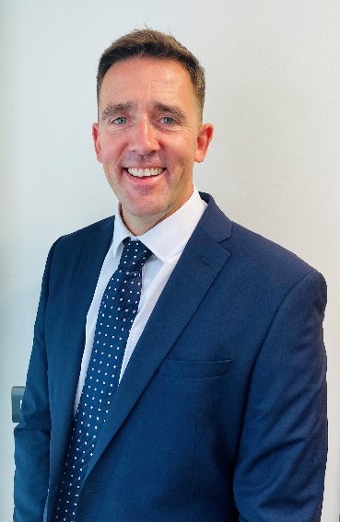
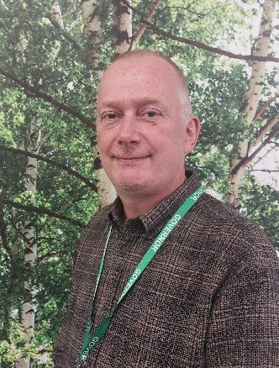

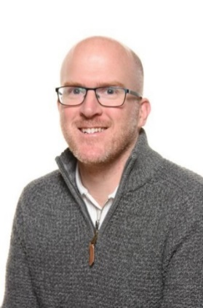
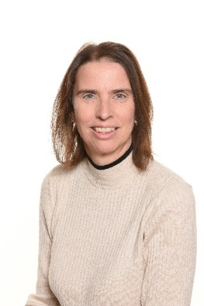
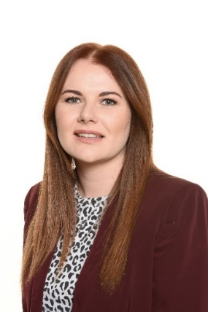
STAYING SAFE
at Poolsbrook Primary School
Are you feeling worried about yourself or someone else?
Do you want to talk to someone who can help?
Mr Stewart
Senior Designated Safeguarding Lead
Mr Hinitt
Safeguarding
Governor
Mr Chalkley
Deputy Designated Safeguarding Lead
Miss Goodwin
Deputy Designated Safeguarding Lead
Mrs Holland
Deputy Designated Safeguarding Lead

